Slide 1

Project 5
CSE 535 MOBILE COMPUTING
FALL 2023
Elevate Your Health, Transform Your Life
FitLife
Your Daily Score to Wellness Excellence!
Group 42
Raviteja Reddy Guntaka
Laksh Gangwani
Pranav Bhargav Gopinath
Kedar Sai Nadh Reddy Kanchi
Archit Agrawal
Shrey Bharatbhai Bhadiyadara

Slide 2
Problem Addressed
One centralized App to track fitness
Our app can help to track all metrics of user, thus saving time and giving
more informed records for user to track.
Personal Fitness Routine
Provide a context aware, personalized routine updating regularly
Provide daily motivation
Novel daily score system that serves as a motivation

Slide 3
Goal
The ultimate goal of FitLife is to foster a culture of proactive well-being and exercise. By combining data-driven decision-making, motivational daily scoring, and personalized fitness routines, the application aims to empower users to take charge of their health. Achieving a daily score of 75 or above becomes a motivating factor for individuals to continually advance their fitness and health, ultimately enhancing their overall quality of life.

Slide 4
Alignment with Guardian Angel
The FitLife application endeavors to instill a motivation to actively promote well-being through a meticulous scoring engine.
The Workout Suggestion Model provides users with user-specific customizability. This empowers users in curating fitness routines fostering a more personalized and effective approach to their well-being journey.
Additionally, tracking user's progress in the last 30 days, including weight, heart rate, respiratory rate, and daily score for motivating users to continually advance their fitness and health, ultimately enhancing their overall quality of life.
All these aspects of FitLife align with the Guardian Angel’s aim to foster a culture of proactive well-being and provide context-based personalized suggestions.
Notes:
In coherence with the overarching vision of Guardian Angel, the FitLife application endeavors to instill a proactive well-being culture through a meticulous scoring engine.
The Workout Suggestion Model provides users with user-specific customizability. This empowers users in curating fitness routines that can cater to users gym experience, preferences, and desired intensity, fostering a more personalized and effective approach to their well-being journey.
Additionally, displaying the user's progress in the last 30 days, including weight, heart rate, respiratory rate, and daily score, is essential for motivating users to continually advance their fitness and health, ultimately enhancing their overall quality of life.

Slide 5
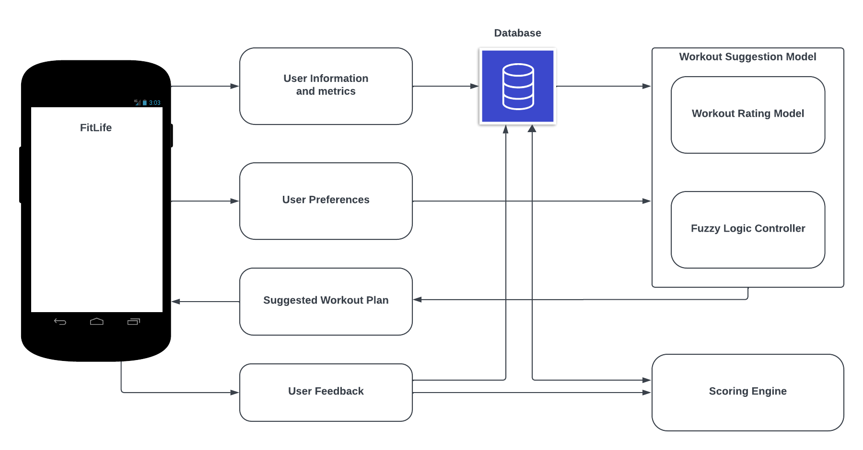
Design

Slide 6
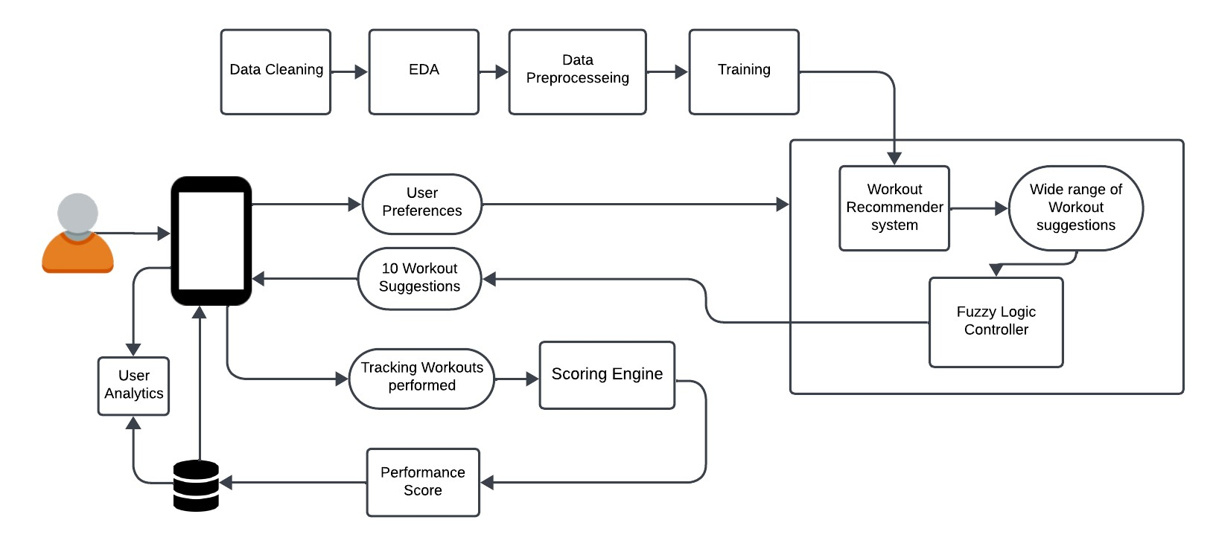
Methodology

Slide 7
Methodology: Activity Interface
The Activity Suggestion Page plays a pivotal role in this system, employing a data-driven approach to recommend customized exercises that align with user preferences and fitness goals.
The user interacts with the multi-select dropdowns to choose their preferred muscle groups and exercise types.
Valid inputs are then sent to the fuzzy logic controller for interpreting the user's preferences.
The fuzzy logic controller processes the inputs against a predefined set of rules and workout data.
This interactive list allows users to mark off exercises as they complete them, which enhances user engagement and provides a sense of accomplishment.
Notes:
The Activity Suggestion Page plays a pivotal role in this system, employing a data-driven approach to recommend customized exercises that align with user preferences and fitness goals.

Slide 8
Methodology: Workout Suggestion Model
The Suggestion Model provides personalized gym workout suggestions based on exercise type, targeted body parts and user rating.
User rating is calculated based on heart rate, respiratory rate, BMI, and recent workout scores.
The results from the recommender system go to the fuzzy controller which further breaks down the results to give the top 10 workouts for the user.
The user can choose the exercise’s of his choice from this list of suggestions and record the percentage of the exercise he is able to accomplish.
This serves as user feedback and helps in scoring the users efforts for the day. Which further helps in improving workout suggestions going further.

Slide 9
Methodology: Scoring Engine
The Scoring engine employs a fuzzy logic system, utilizing parameters such as heart rate, respiratory rate, BMI, and exercise completeness.
The goal is to inspire users to reach a daily score of 75 or above, which will motivate continual advances in overall health and fitness.
The initial phase of the Scoring Engine involves the collection and processing of user preferences, information, metrics, and feedback.
The second phase employs a fuzzy logic system, where data collected during exercise is processed for relevant parameters.
The last step which is defuzzification, Mean of Maximum defuzzification is utilized to calculate exercise score.
Notes:
This engine employs a fuzzy logic system, utilizing parameters such as heart rate, respiratory rate, BMI, and exercise completeness.

Slide 10
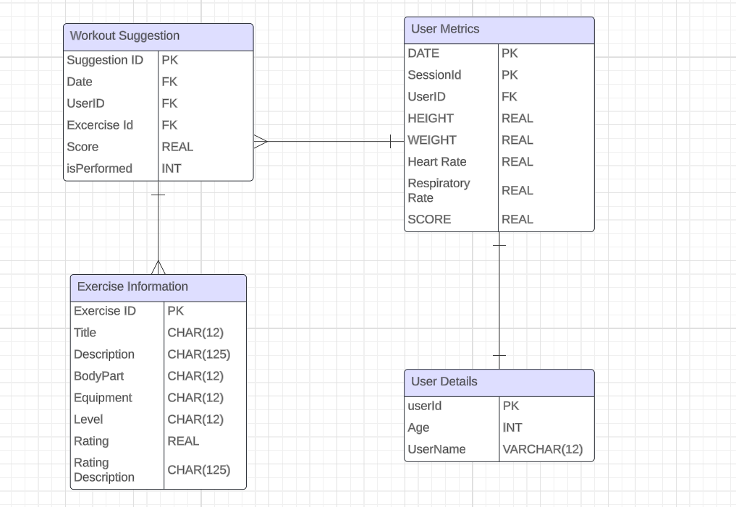
Methodology: Database

Slide 11
Navigating Challenges
CameraX library dependency incompatibility with different versions of Kotlin → Manually checking and updating Kotlin version to get correct compatible Kotlin version
Package with conflicting dependencies caused project to crash several time → Navigating through each dependencies and updating them ensuring running FitLife Application
Defining fuzzy logic parameters for scoring engine as there were too many input parameters → Cut done user metrics by defining routine based workout suggestions and access workout sessions according to user preferences
High task interdependence between Group members → Planning ahead of the time and communication regarding merging of dependencies of tasks
Generating suggestions from large pool of workout database → Creating rating based suggestions mechanism that gives exercises from particular range of rated exercises

Slide 12
Individual Contribution
Task | Task Description | Implemented by
1 | Data Preprocessing and Exploratory Data Analysis | Pranav
2 | Workout Rating Model and Fuzzy Logic Controller (Suggests personalized exercises) | Raviteja
3 | Scoring Engine | Shrey
4 | DB Schema Modeling (SQLite) | Archit
5 | Activities: Suggested Workout details and User Feedback | Laksh
6 | Activities: User Metrics Collection and Progress Analysis | Kedar
7 | App integration, deployment and testing | All team members

